Slide 1


Graph Neural Network in Practice
For Discovery, Adventure, Momentum and Outlook
Dr. Hongxia Yang
Senior Staff Data Scientist

Slide 2
01
Part 1
Overview
contents
02
Part 2
Graph Neural Network in Practice
03
Part 3
Cognition

Slide 3
01
Part 1
Overview

Slide 4
Graph Data is Prevalent
Social networks
The Internet graph
Traffic graph (Visualization of global flights)
Electricity grid
(Blackout of August 14, 2003)
On-line behavior targeting
Gene analysis

Slide 5
Why Graph and Graph Neural Network?
Graph computing models are very popular in big data companies, especially IT companies, as they are the most straightforward solutions to many practical problems
Traditional recommendation and CTR/CVR prediction problems can be equivalently modeled with the attributed user-item bipartite graphs
Objective functions are more general: global optimization vs conditional independent optimization; Hands-free crafted feature engineering
Introducing high-level proximity samples and their modeling brings both risks (e.g., noise) and benefits (e.g., more generalization and exploration, predictive graph changes)
Pure deep learning is mature, graph embedding that combines both deep learning and graph computing integrating end-to-end learning with inductive reasoning, which is expected to solve the relational reasoning that deep learning cannot perform^{[1]}.
^{[1]} Relational inductive biases, deep learning and graph networks, Battaglia etc, arxiv, 2018.

Slide 6
Challenges
The core steps in GNN are particularly optimized for grid structures, such as images, but not feasible for graphs in irregular Euclidean space. Thus, existing GNN methods can not scale on real-world graphs with exceedingly large sizes. The first problem is how to improve the time and space efficiencies of GNN on large-scale graphs?
Different types of objects characterize the data from multiple perspectives. They provide richer information but increase the difficulty to map the graph information into a singleton space. Thus, the second problem is how to elegantly integrate the heterogeneous information to be an unified embedding result?
The attribute information can further enhance the power of the embedding results and make inductive GE possible. Without considering attribute information, the algorithms can only consider the transductive settings and ignore the need for predicting unseen instances. However, the topological structure information and unstructured attribute information are usually presented in two different spaces. Thus, the third problem is how to unify them to define the information to be preserved?
As GNN suffers from low efficiency, recomputing the embedding results from scratch with respect to structural and contextual up- dates are expensive. Thus, the fourth problem is how to design efficient incremental GNN methods on dynamic graphs?

Slide 7
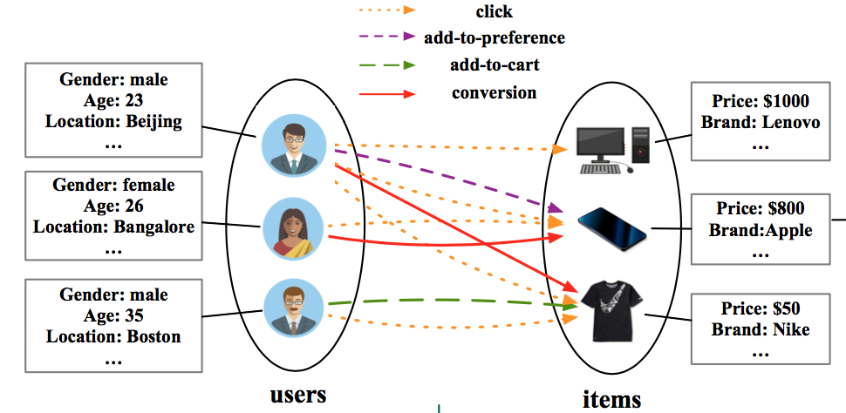
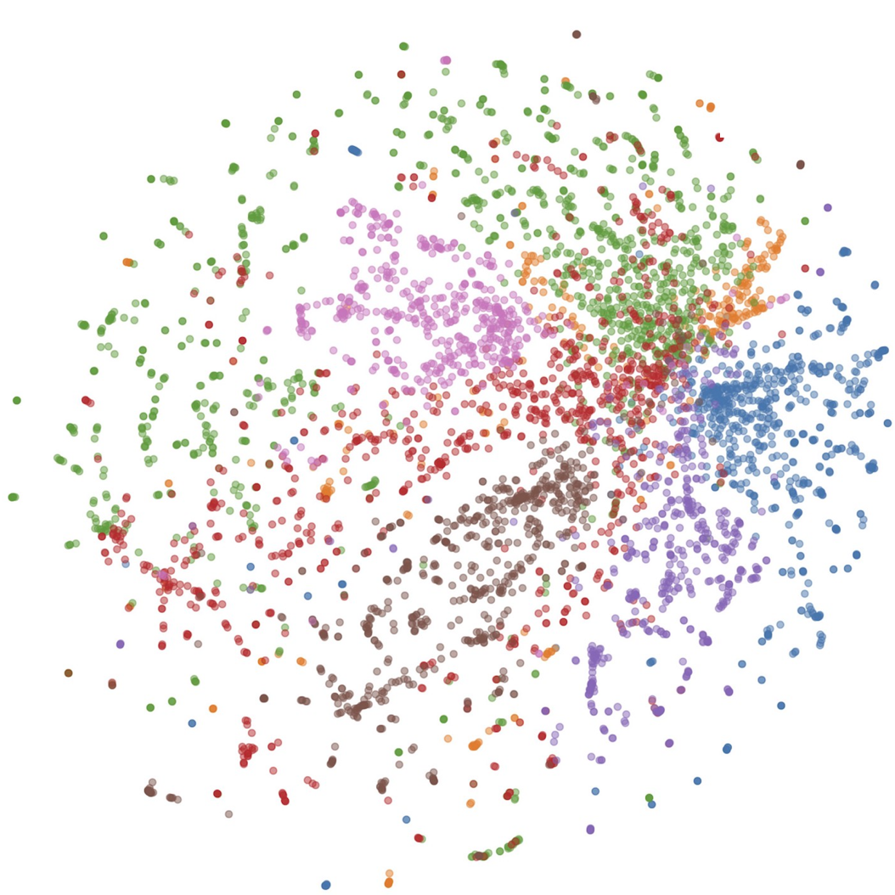
A GE Oriented Recommendation System in Practice
Sampling: Representative and Negative Samples
Multiplex:
Node and Edge Heterogeneities
Mixture Modes:
Users with Different Latent Interest Categories
Hierarchical:
Users’ community structures and items’ categories
Extremely Large Scale Attributed Heterogeneous Graphs with Billions of Nodes and Trillions of Edges
Unified Graph Embeddings for Both Various Topological and Attributed Spaces
Practical Challenges and Our Current Focuses

Slide 8
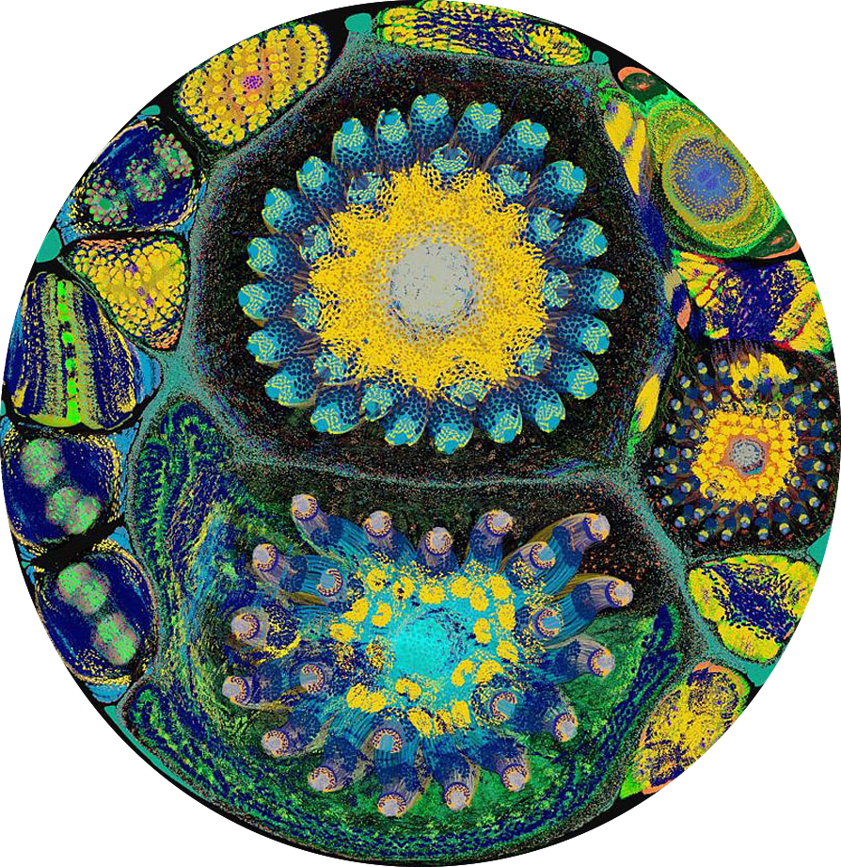








Cognitive Intelligence Algorithm Platform
Large Scale Graph Neural Network Oriented
Material, Entertainment and Health
Alibaba Economy Big
Data Platform
Lead Consumers Lives
Text, image and video influence the mind of consumers
GNN Build Personalized Super Brain
Capable of inductive reasoning, explainable, better know consumers than themselves

Slide 9
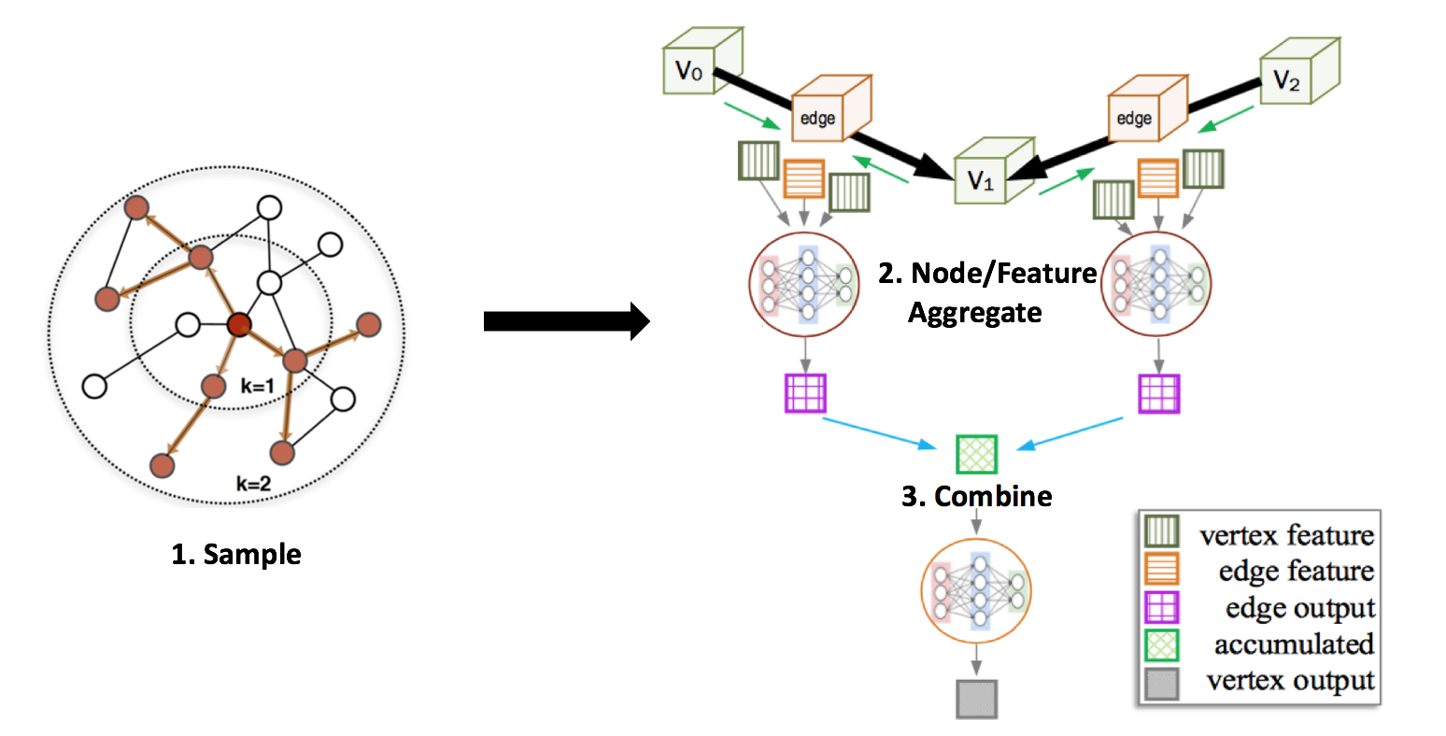
GNN Framework Overview

Slide 10
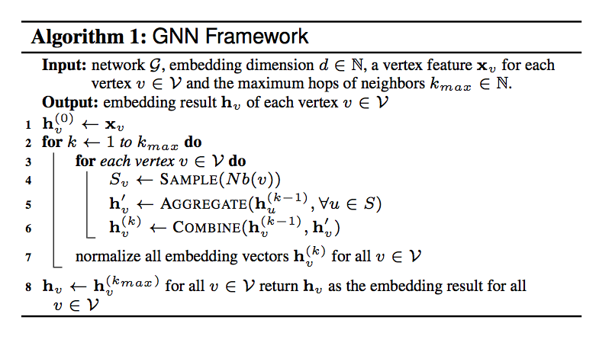
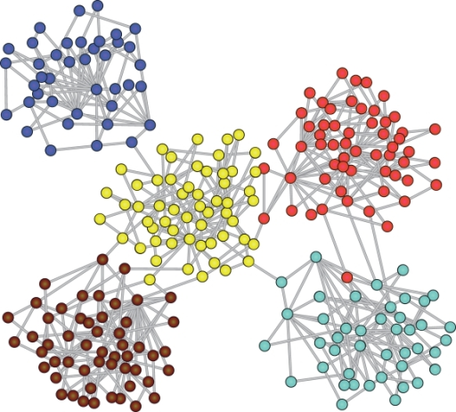
System Optimizations
Embedding h
Graph partitioning and clustering
Co-locate embedding variables with graph partitions
Reuse embedding if possible

Slide 11









GNN Platform Overview
AliGraph: A Comprehensive Graph Neural Network Platform. 45th International Conference on Very Large Data Bases (VLDB), 2019.
RAW DATA
PROCESS
DISPATCH & LOAD
TRAINING
INFERENCE
OUTPUTS
FEEDBACK
Node
prediction
Edge
prediction
Community detection
Pattern
Recognition
Dynamic graph
PARALLEL LEARNING AND INFERNCE
EXTREMELY LARGE SCALE GRAPHS
1. Rich algorithm warehouse with improved accuracy measures (5%-90%) for practical
challenges;
2. Performs an order of magnitude faster in terms of graph building, e.g., 492.90 million
vertices, 6.82 billion edges and rich attributes, 2 minutes vs hours by other state-of-
the-arts;
3. 40%-50% faster with the novel caching strategy and demonstrates around 12 times
speed up with the improved runtime.
PS
PS
Extremely
Large
Scale
Graph
Represent-ation
Platform
PS
Billions of nodes, trillions of edges
PARAMETERS
GRADIENTS
Load
WORKER
WORKER
Built in
Algo
Store
Apply
Data Sources
Graphs
Sample
Aggregate
Merge
WORKER
TensorFlow
MPI
Heterogeneous Graph
Computing
CPU
GPU

Slide 12
02
Part 2
Graph Neural Network in
Practice

Slide 13
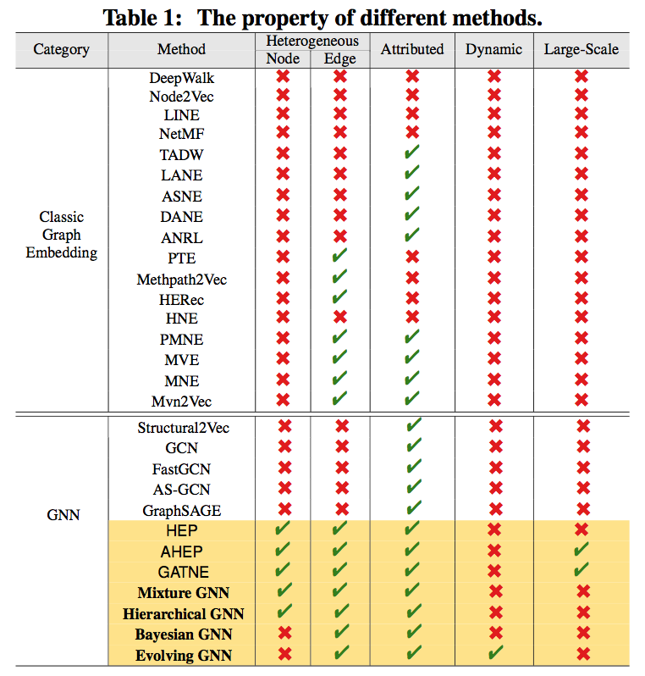
Various GE/GNN Methods

Slide 14
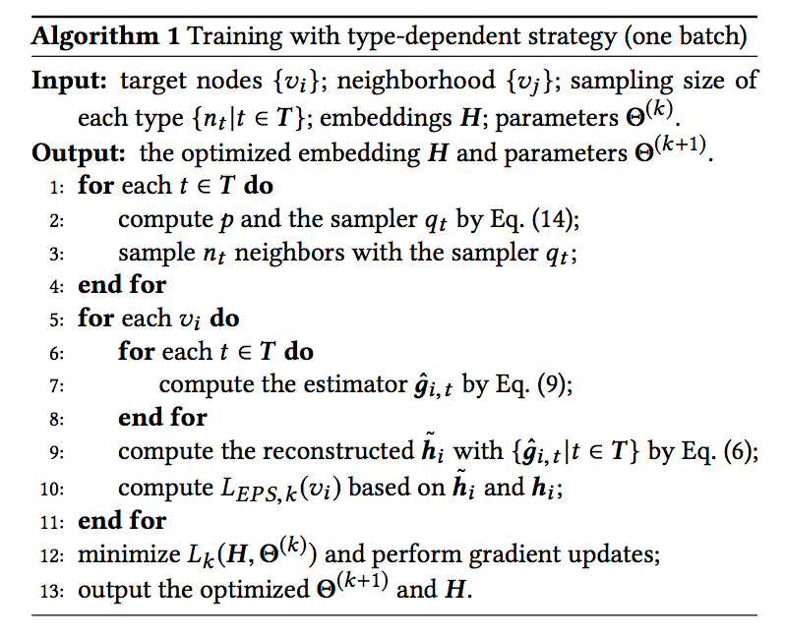
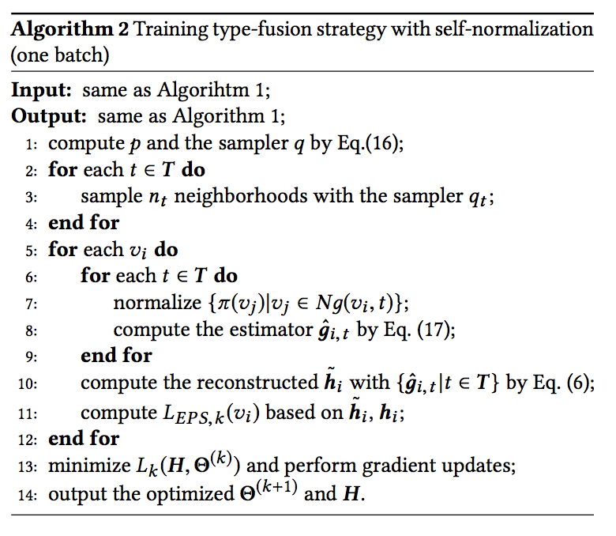
Sampling
Accelerating Large-Scale Heterogeneous Interaction Graph Embedding Propagation via Importance Sampling, in submission
Representative and negative sampling
Borrow idea from importance sampling
Extend node-wise to batch-wise sampling
Type-dependent & -fusion sampling with self-normalization
Computational complexity drops from O(|E|+|V|) to O(|V|)

Slide 15
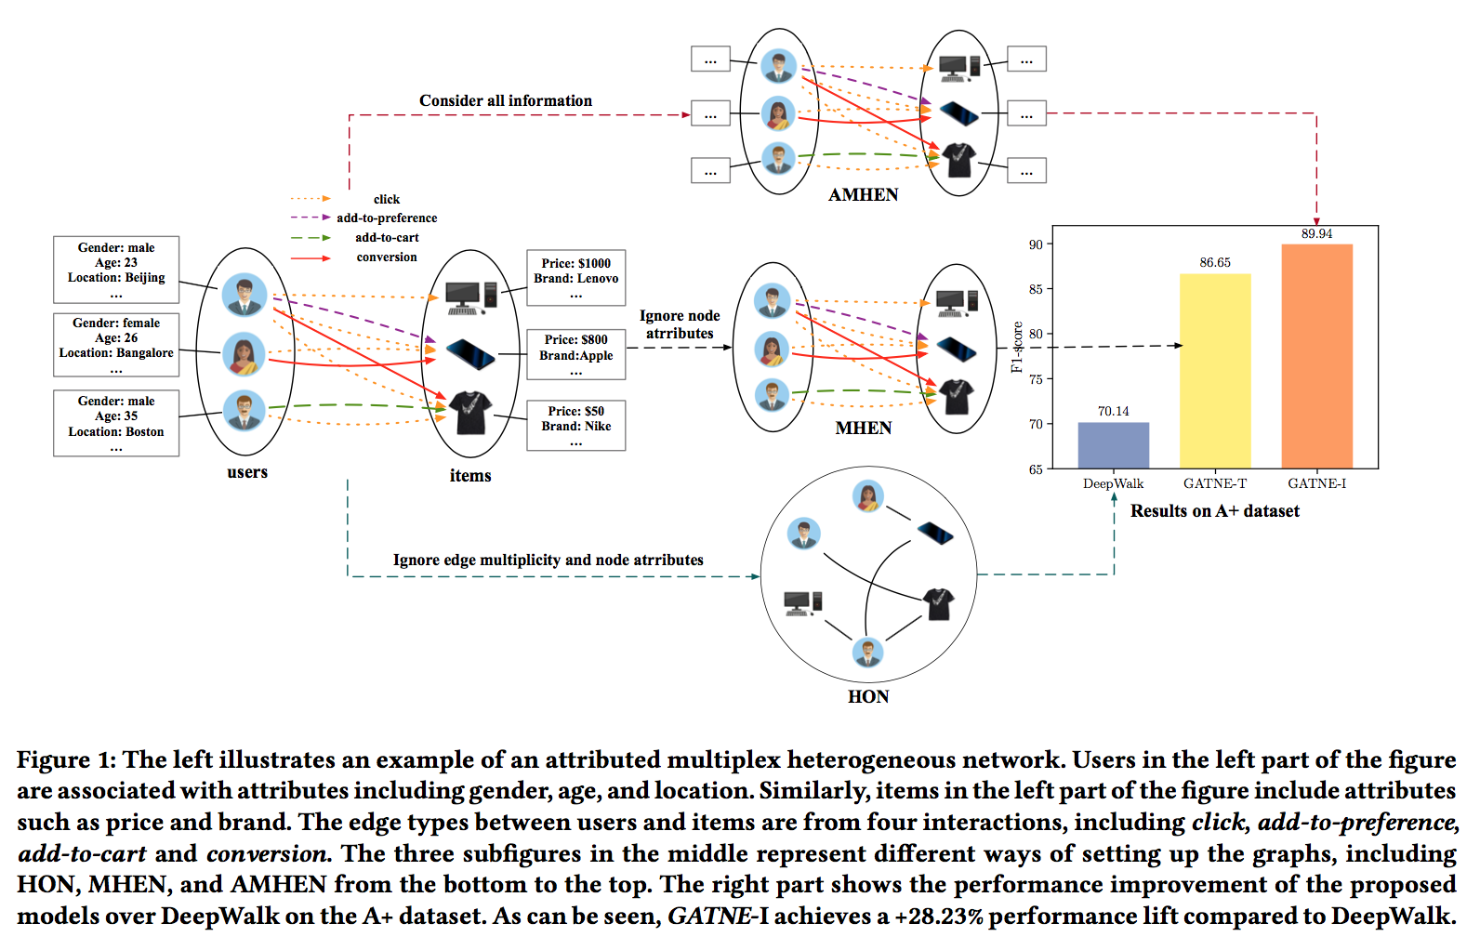
Multiplex
Representation Learning for Attributed Multiplex Heterogeneous Network, KDD 2019

Slide 16
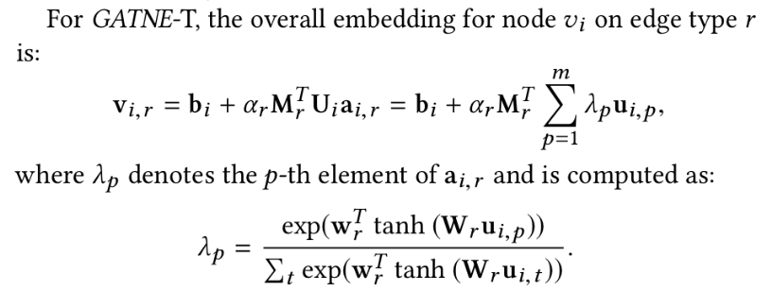

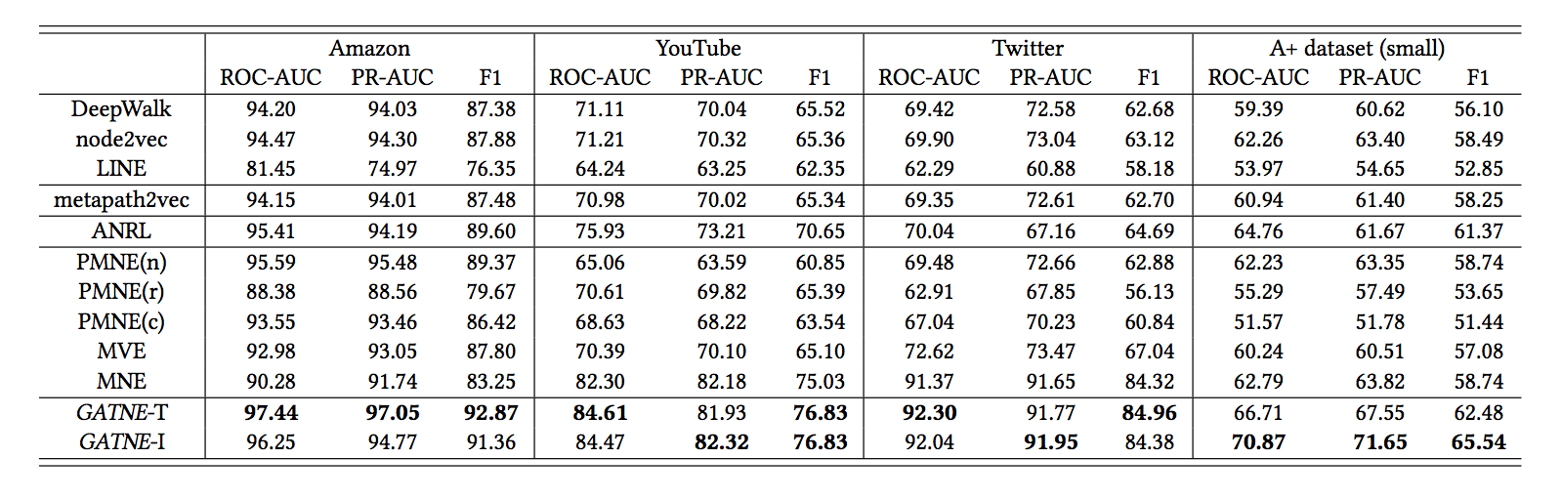
Transductive Model:
Inductive Model:

Slide 17
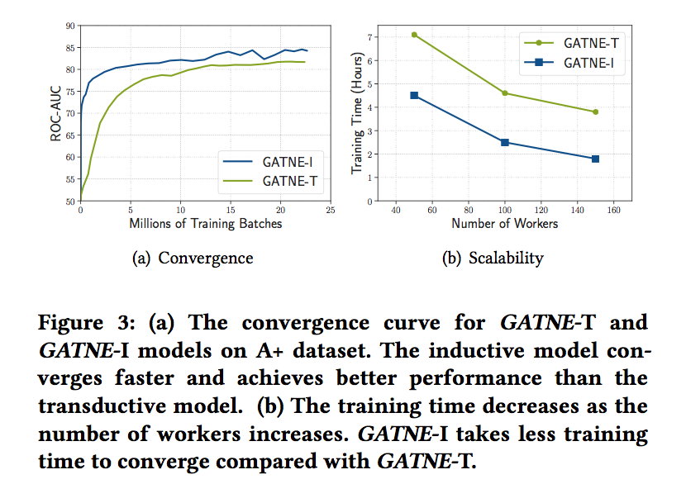

Slide 18
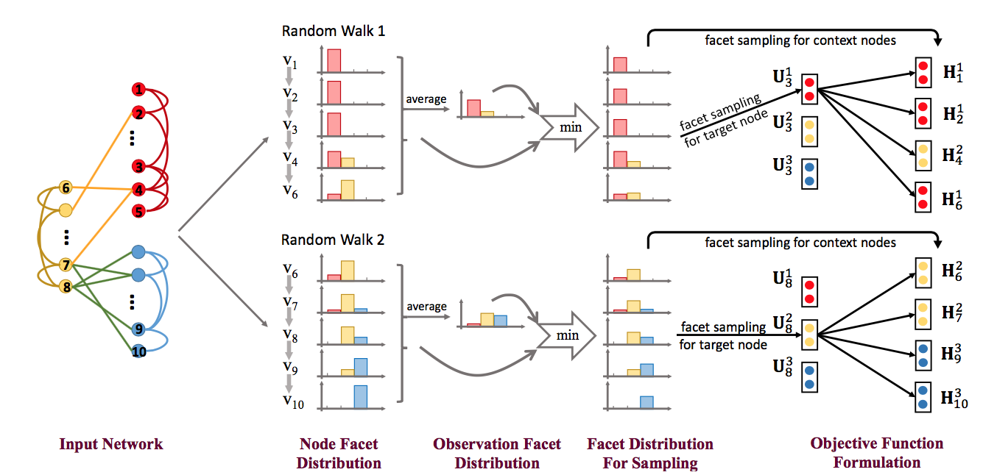
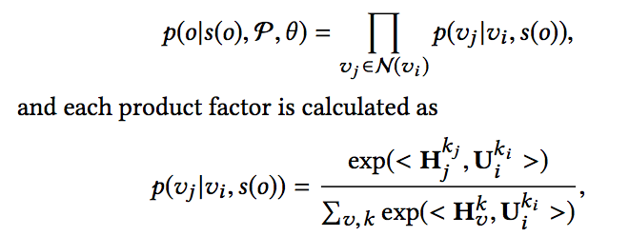
Mixture GNN
Is a Single Vector Enough? Exploring Node Polysemy for Network Embedding, KDD 2019

Slide 19
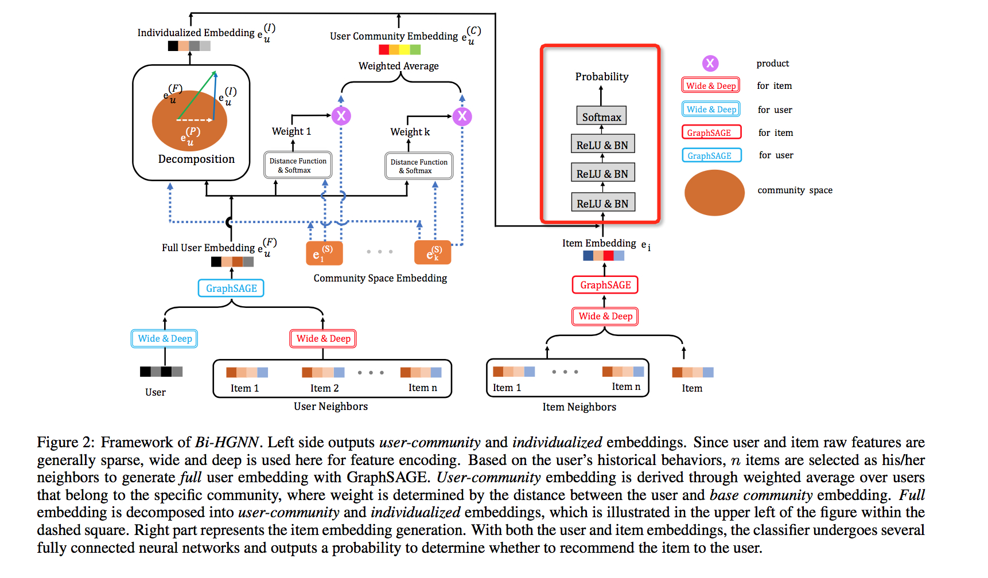
Hierarchical GNN
Hierarchical Representation Learning for Bipartite Graphs, IJCAI 2019

Slide 20
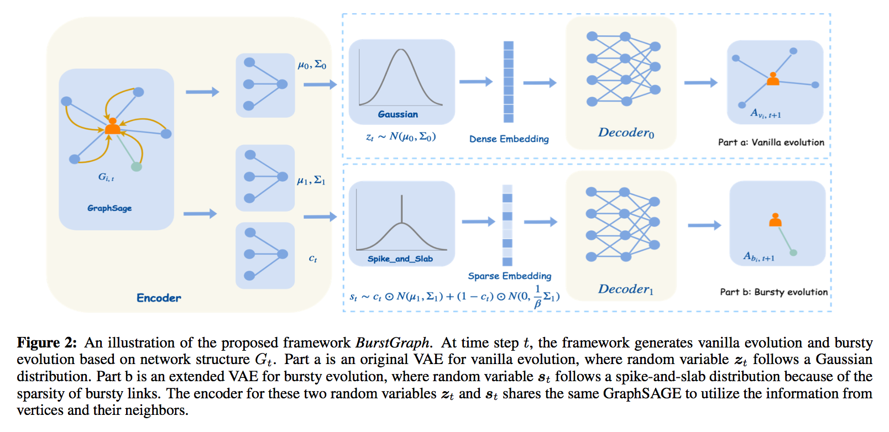
Evolving GNN
Large Scale Evolving Graphs with Burst Detection, IJCAI 2019

Slide 21
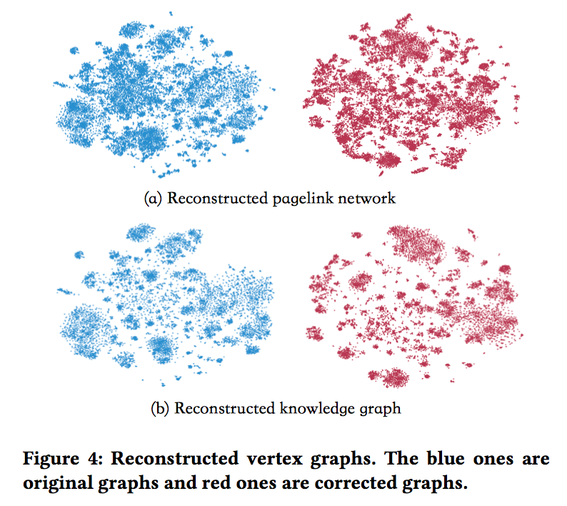
Bayesian GNN
Refining Representation by Integrating Knowledge Graphs and Behavior-specific Networks, CIKM 2019
BEM is proposed to bridge KG and BG seamlessly, with the consideration of the behavior-specific bias. This framework provides a new perspective of making a reasoning mechanism (cognitive graph).
As a method, BEM is generic and flexible in that it can use any KG embeddings to correct any BG embeddings. On the contrary, it is potentially able to help KG embeddings acquire novel knowledge from the BG embeddings that does not exist in the knowledge graph.

Slide 22
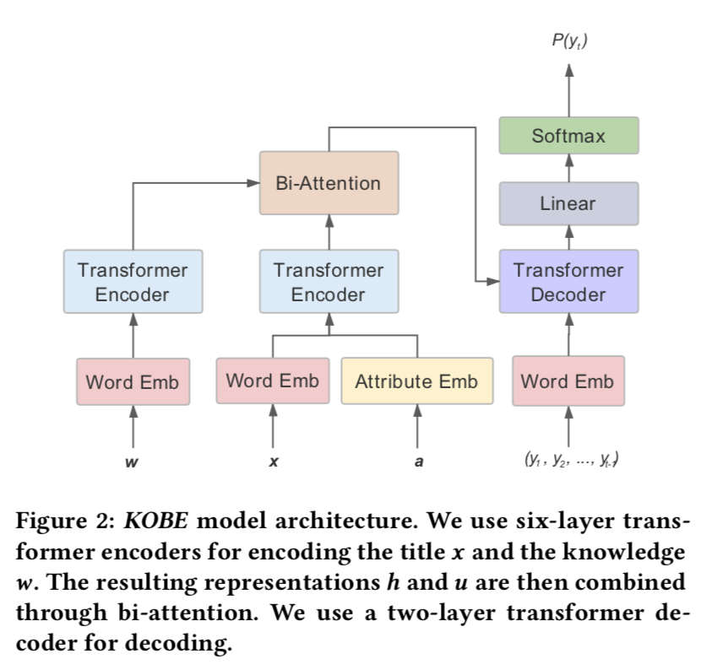
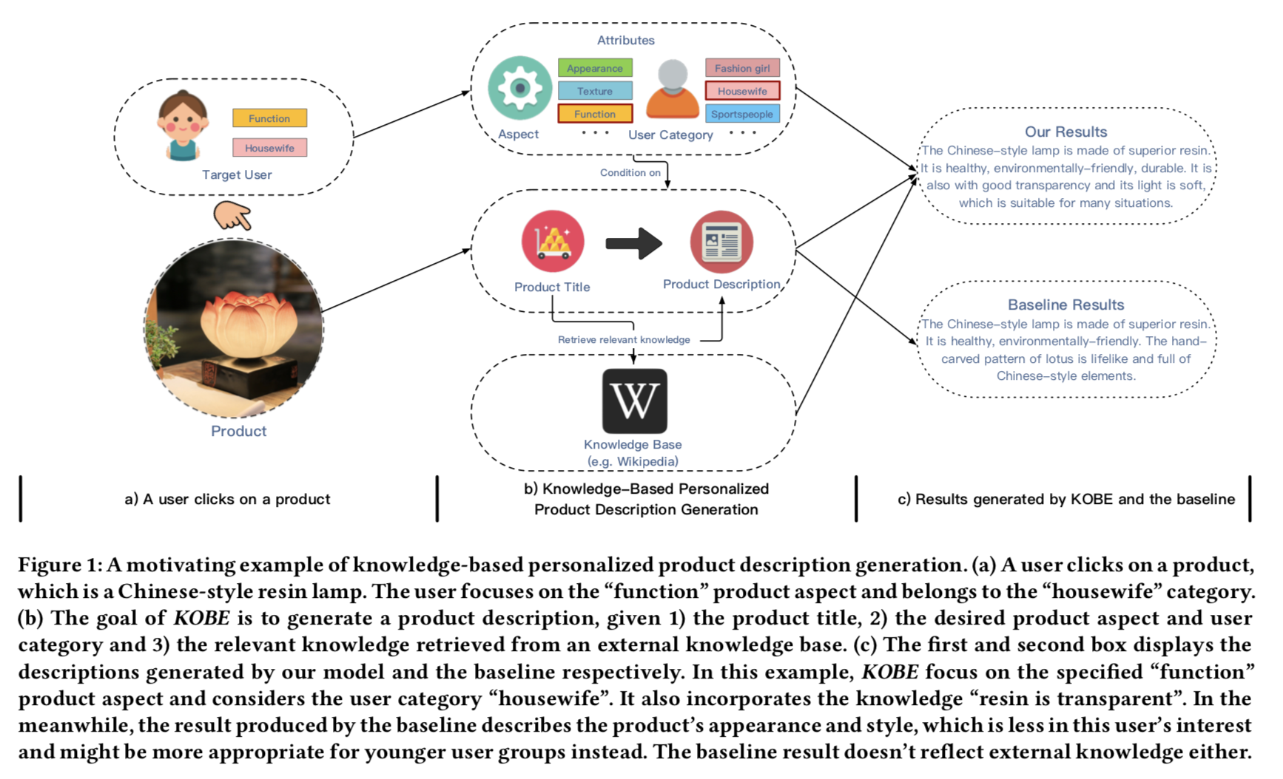
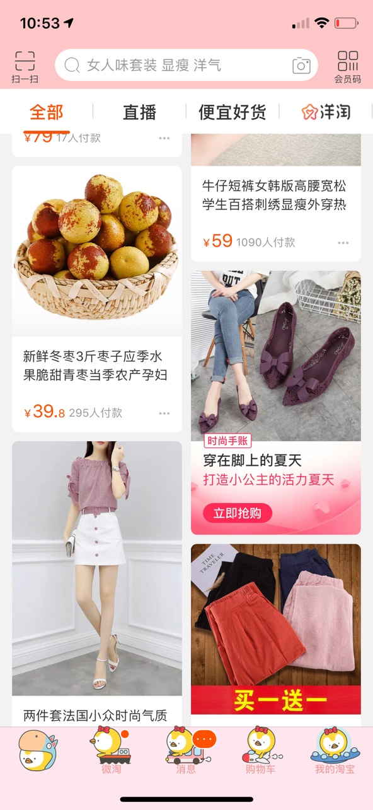
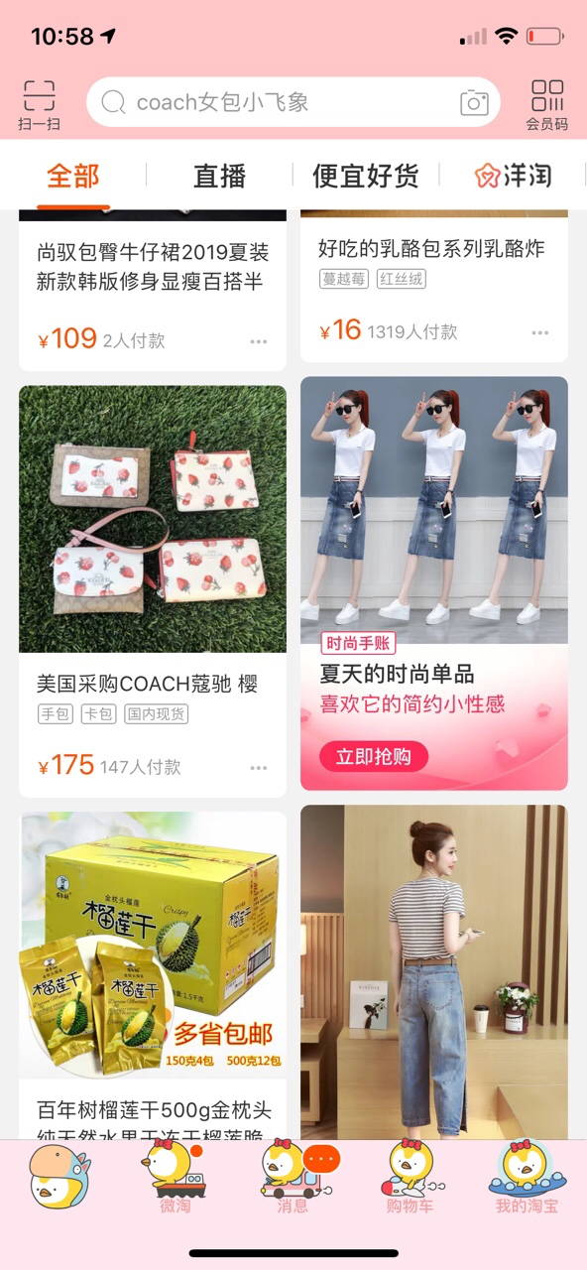
Cognitive GNN
Towards Knowledge-Based Personalized Product Description
Generation in E-commerce, KDD 2019

Slide 23
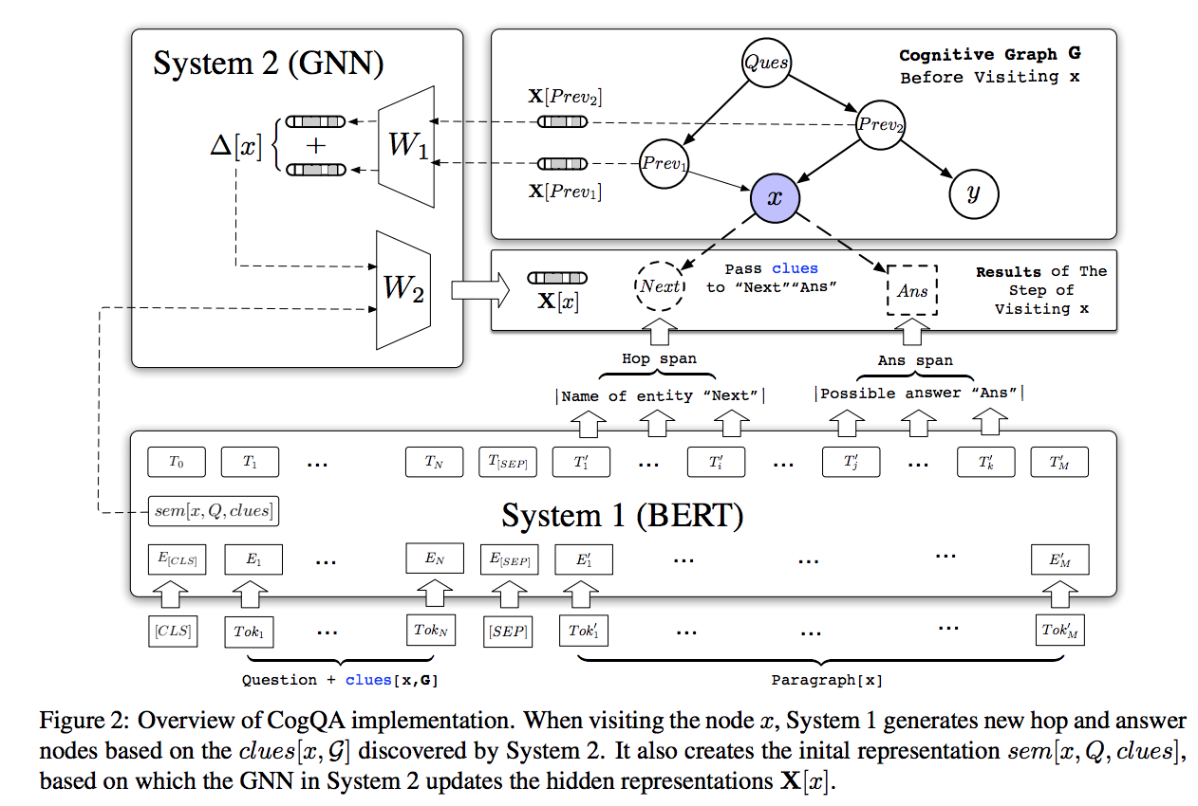
Cognitive GNN
Cognitive Graph for Multi-Hop Reading Comprehension at Scale, ACL 2019

Slide 24
Selected Publications
1. Representation Learning for Attributed Multiplex Heterogeneous Network. 25th ACM SIGKDD Conference on Knowledge Discovery and Data Mining (KDD), 2019.
2. Is a Single Vector Enough? Exploring Node Polysemy for Network Embedding. 25th ACM SIGKDD Conference on Knowledge Discovery and Data Mining (KDD), 2019.
3. Towards Knowledge-Based Personalized Product Description Generation in E-commerce. 25th ACM SIGKDD Conference on Knowledge Discovery and Data Mining (KDD), 2019.
4. Sequential Scenario-Specific Meta Learner for Online Recommendation. 25th ACM SIGKDD Conference on Knowledge Discovery and Data Mining (KDD), 2019.
5. AliGraph: A Comprehensive Graph Neural Network Platform. 45th International Conference on Very Large Data Bases (VLDB), 2019.
6. Large Scale Evolving Graphs with Burst Detection. 28th International Joint Conference on Artificial Intelligence (IJCAI), 2019.
7. Hierarchical Representation Learning for Bipartite Graphs. 28th International Joint Conference on Artificial Intelligence (IJCAI), 2019.
8. Cognitive Graph for Multi-Hop Reading Comprehension at Scale. 57th Annual Meeting of the Association for Computational Linguistics (ACL), 2019.
9. Subgraph-augmented Path Embedding for Semantic User Search on Heterogeneous Social Network, WWW, 2018.
10. ANRL: Attributed Network Representation Learning via Deep Neural Networks, IJCAI, 2018.
11. Adversarial Detection with Model Interpretation. KDD, 2018.
12. SPARC: Self-Paced Network Representation for Few-Shot Rare Category Characterization. KDD, 2018.
13. Mobile access record resolution on large-scale identifier-linkage graphs. KDD, 2018.
14. Interactive Paths Embedding for Semantic Proximity Search on Heterogeneous Graphs. KDD, 2018.
15. PRRE: Personalized Relation Ranking Embedding for Attributed Network. 27th ACM International Conference on Information and Knowledge Management (CIKM), 2018.
17. Heterogeneous Embedding Propagation for Large-scale E-Commerce User Alignment, 2018 IEEE International Conference on Data Mining (ICDM), 2018
18. Local Algorithm for User Action Prediction Towards Display Ads. 23rd ACM SIGKDD Conference on Knowledge Discovery and Data Mining (KDD), 2017.
19. Hybrid Framework for Text Modeling with Convolutional RNN. 23rd ACM SIGKDD Conference on Knowledge Discovery and Data Mining (KDD), 2017.
20. Bayesian Heteroscedastic Matrix Factorization for Conversion Rate Prediction. 26th ACM International Conference on Information and Knowledge Management (CIKM), 2017.
21. Will Triadic Closure Strengthen Ties in Social Networks?, ACM Transactions on Knowledge Discovery from Data (TKDD), 2017.

Slide 25
03
Part 3
Cognition

Slide 26
认知推理
什么是认知推理？
补水 vs 90后女生熬夜需要补水
为什么做认知推理？
大超市 -> 个性化货架（千人千面）-> 个性化货架+AI导购员（认知推理）
基于认知推理推荐
商品知识图谱
+
人类认知常识
内容化展现
内容商业化
产生推荐理由和召回相关视频
/文本
视频检测商品/文本挂靠商品
基于GNN的推理引擎：购买意图识别
引入达人文案：商品和常识链接

Slide 27
内容化和内容商业化
电商内容化
电商营销
内容检测商品
把产品或者品牌的的调性、风格做成专业、好玩、有趣、有灵魂，呈现这些的具体过程就是内容化。表现形式可以是文字、图片、短视频、直播、VR/AR等
古典电商：直通车/淘客/钻展/搜索
现代电商：内容/达人/直播/私域
对PGC（达人）内容根据图像相似性和语义相似性剪裁和挂载相关商品

Slide 28
技术建设和沉淀
最大的商品检测数据集
商品相关性检测
使用拍立淘API自建350W电商商品检测数据集，业界最大
融合Google open imageV4 600->339
Faster-rcnn Pre-model
基于拍立淘商品检索结果之上，基于图像和语义以及类目特征，训练DNN模型做二次商品相关性检测，正确率提升15%
沉淀检测商品相关性数据20万条
服饰商品检测框打分
候选商品检测框过滤
基于DeepFasion2和自建手淘数据集训练服饰候选框正面、完整等属性打分，将打分模块集成到faster-rcnn检测模型，object detection with proposal scoring
基于ImageNet和Tencent-ml万分类等分类数据集，对候选检测框中非商品图片进行过滤

Slide 29

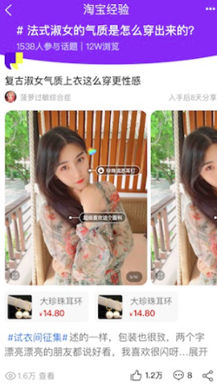

Slide 30

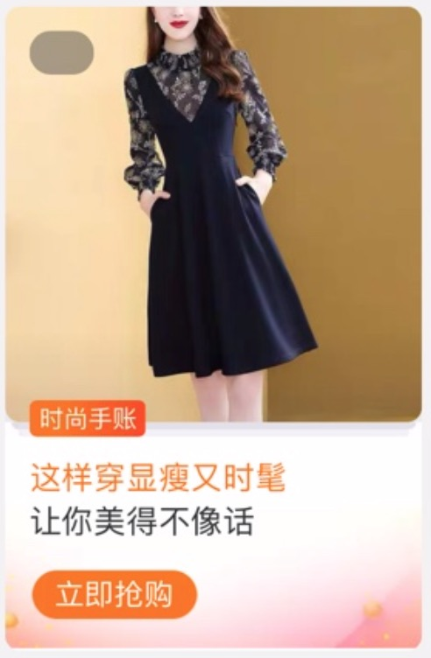
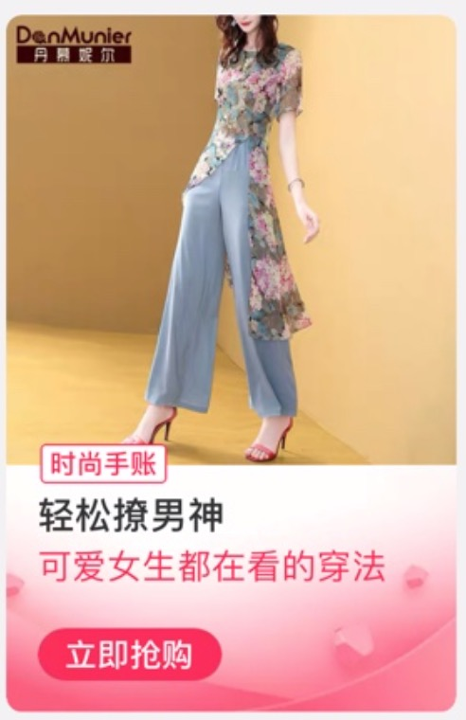
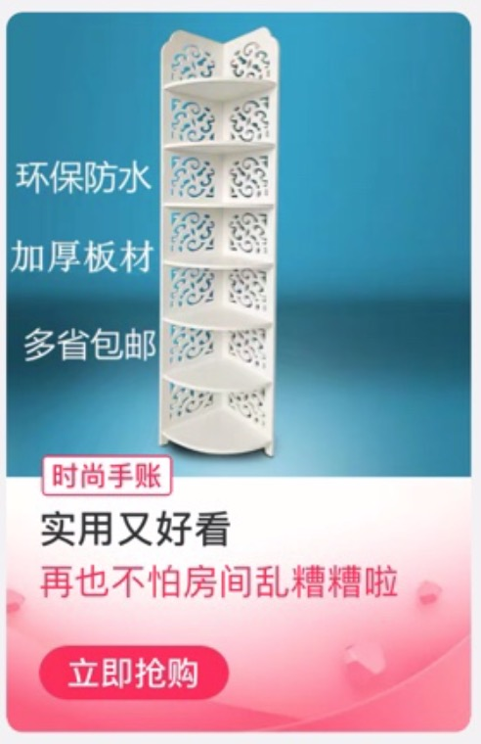
主题推荐

Slide 31
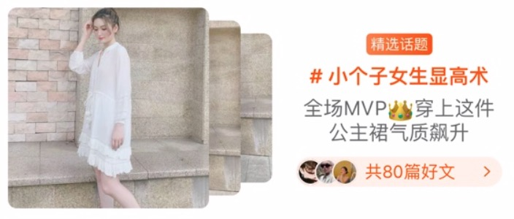
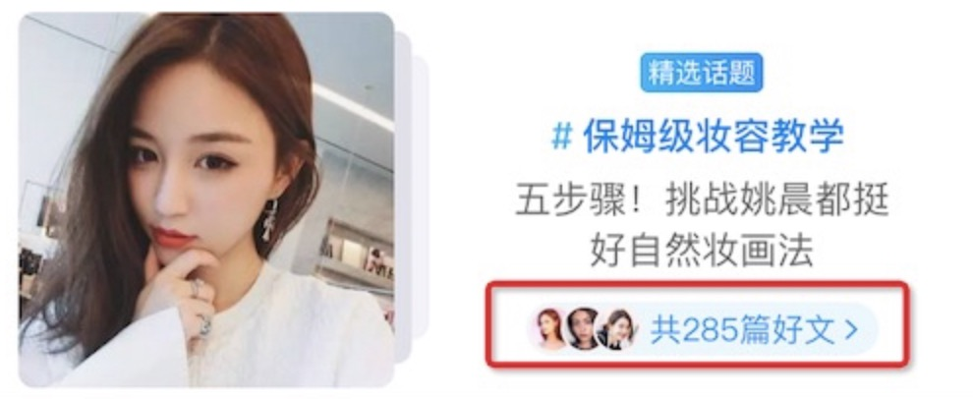
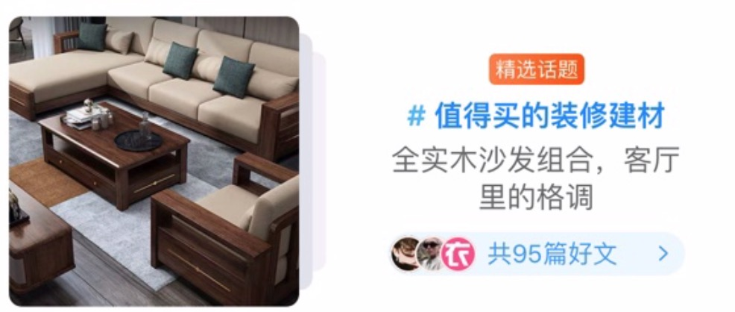
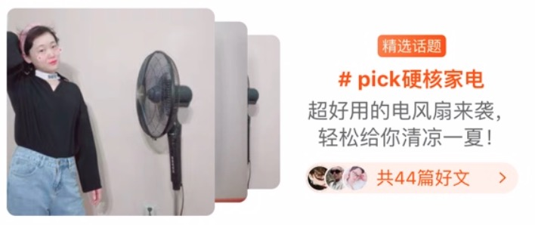
搜索话题

Slide 32
技术建设
框架建设
预训练模型
集团内首次使用Transformer和LightConv做推荐理由、云主题标题生成任务
基于BERT的工作和PAI团队合作，基于电商的超大规模文本+图片预训练模型
文本生成
认知图谱
基于知识的个性化推荐理由生成 KDD19
知识图谱驱动的对话式推荐系统
EMNLP19
基于图的多模态文本生成AAAI20
商品知识图谱+人类认知常识

Slide 33
Thanks

